Slide 1
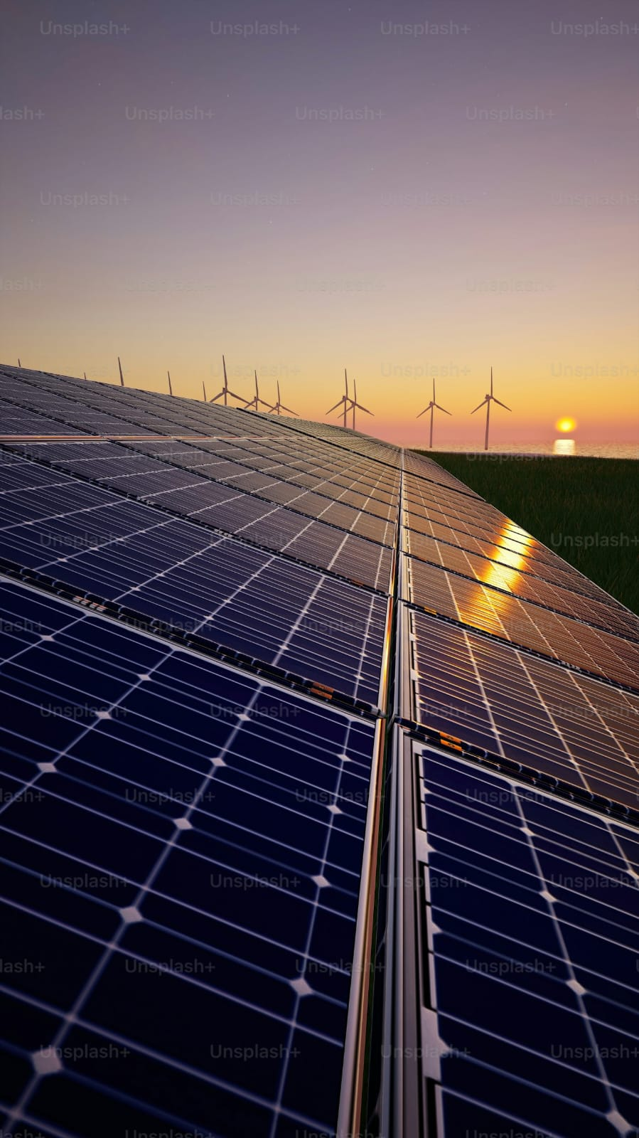
Optimizing Solar Panel Placement
Maximizing Solar Energy Output with Smart Tracking & Optimization
📌 Team Information:-
Team Name: MATLAB Maverick
Team Member: Shukla Kushang Akshay
Institution/Organization: Gujarat Technological University

Slide 2
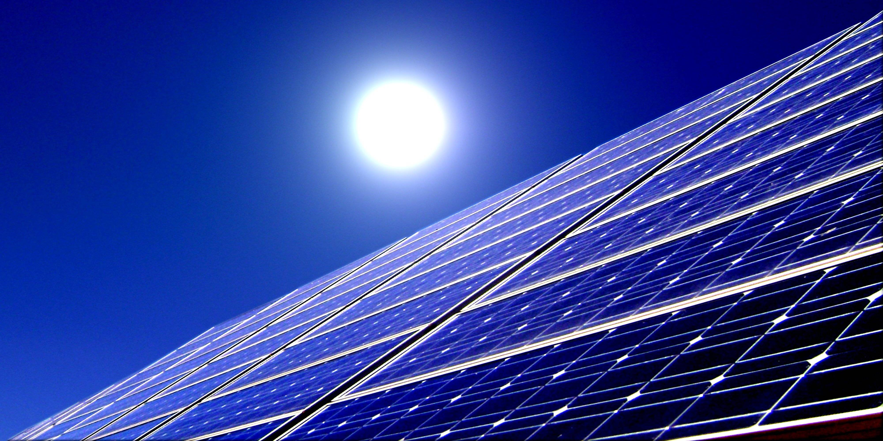
Problem Statement & Motivation
📌 Bullet Points:
Solar power faces 30-40% energy loss due to poor placement & inefficiency.
Shading, seasonal variations, and grid instability reduce performance.
Manual tracking & maintenance is costly & outdated.
📌 Decision Step: ✅ Do we need a smarter system? (YES → Optimize using AI, IoT & GIS!)

Slide 3
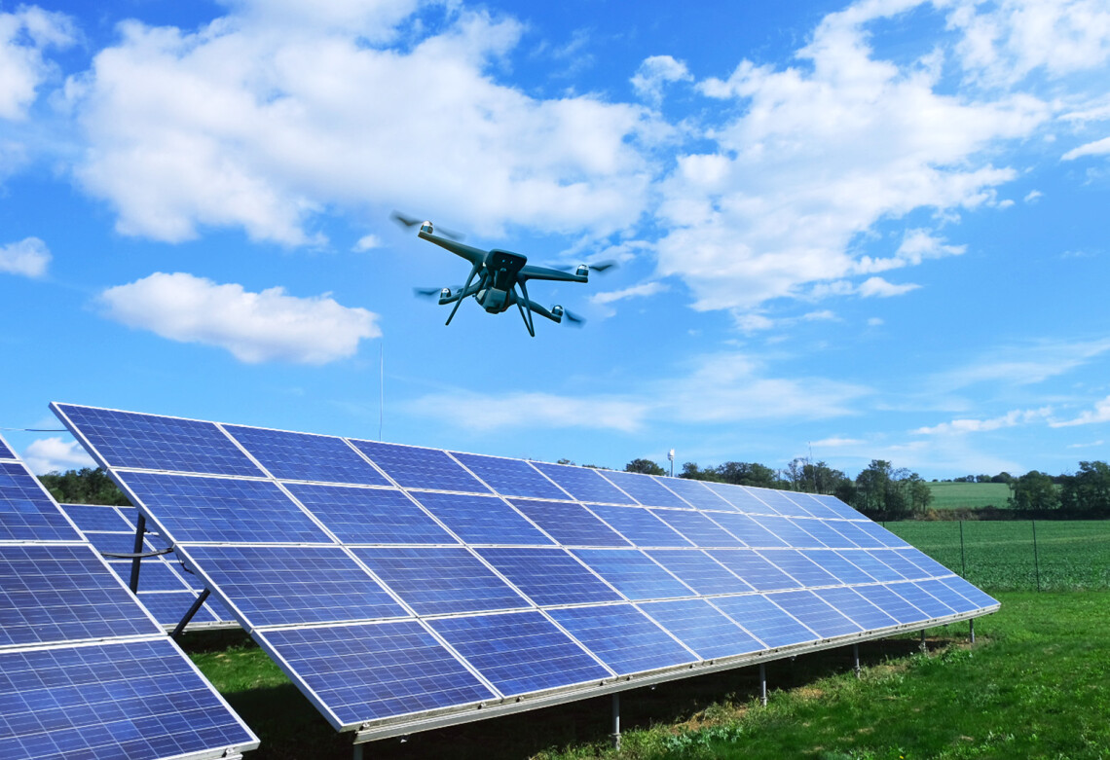
Comparison of Traditional vs Optimized Solar Placement Efficiency
📌 Bullet Points:
Energy Output: Optimized placement boosts efficiency by 20-40% vs. fixed panels.
Space Utilization: GIS-based layouts maximize land use vs. traditional setups.
Sunlight Adaptation: Tracking systems adjust to sunlight; fixed panels don’t.
Maintenance & Lifespan: Optimized systems need more upkeep but last longer.
Cost vs. ROI: Higher initial cost for optimized placement, but better long-term gains.

Slide 4
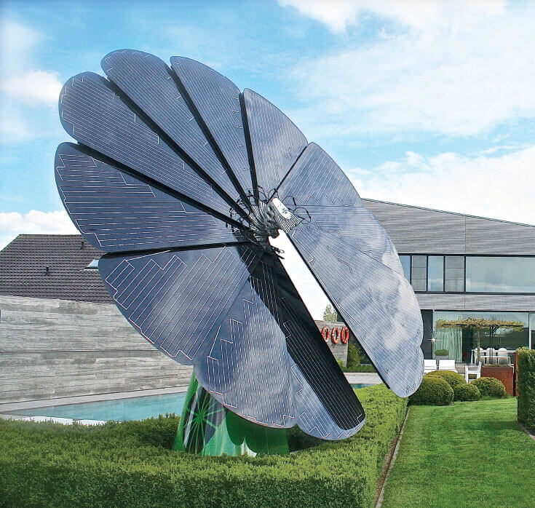
Our Solution – Smart Optimization System
📌 Bullet Points:
AI-powered real-time tilt adjustment.
GIS-based optimal panel placement analysis.
IoT sensors for real-time solar irradiance tracking.
AI fault detection & blockchain-based energy trading.
📌 Decision Step:
✅ Can AI, IoT & GIS increase solar efficiency? (YES → Let’s implement it)

Slide 5
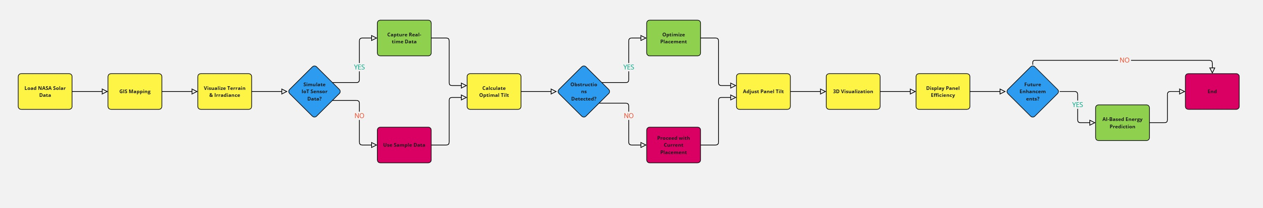
System Architecture (Block Diagram)
📌 Bullet Points:
Step-by-step flow of the system (Data Input → Processing → Decision Making → Output)
Data from IoT sensors, AI models, and GIS maps feed into MATLAB.
Block Diagram

Slide 6
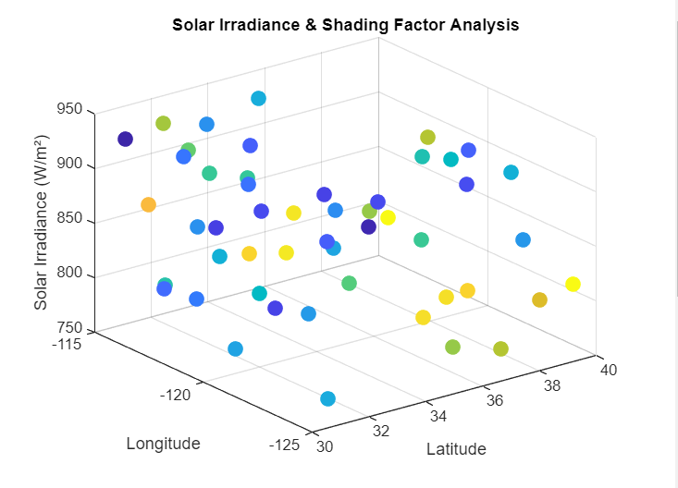
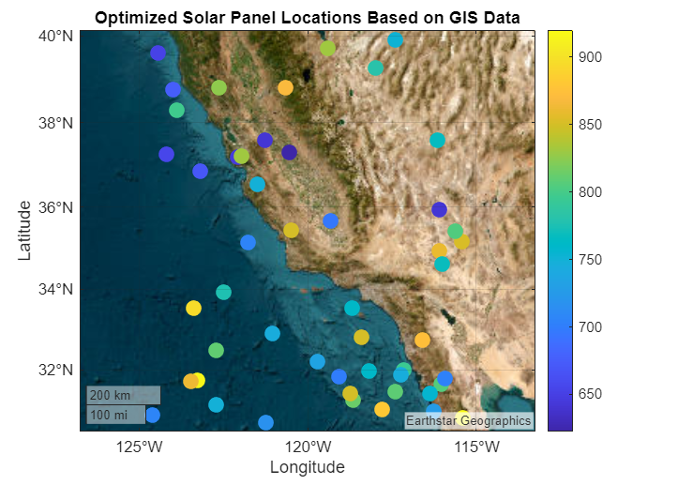
Core Implementation Steps
📌Steps 1-10: Data Processing & Optimization:
Load solar data ✅
Reshape terrain data ✅
Compute sun’s position ✅
Optimize panel tilt dynamically ✅
Perform shading analysis ✅ 📌 Decision Step: Is shading detected? (YES → Relocate panel, NO → Proceed)
Solar Irradiance & Shading Factor Analysis
Optimized Solar Panel Locations Based on GIS Data

Slide 7
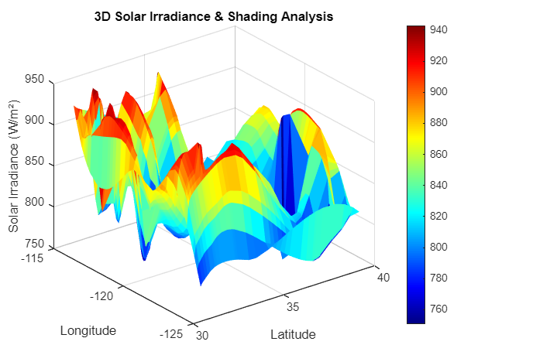
Simulation Outputs & Performance Metrics
📌 Bullet Points:
GIS Heatmap & Terrain Analysis ✅
Solar Irradiance Distribution & Efficiency Calculation ✅
Smart Panel Rotation & Power Grid Synchronization ✅
Blockchain-based Energy Transactions ✅
Optimal Seasonal Tilt Angle
3D Solar Irradiance & Shading Analysis

Slide 8
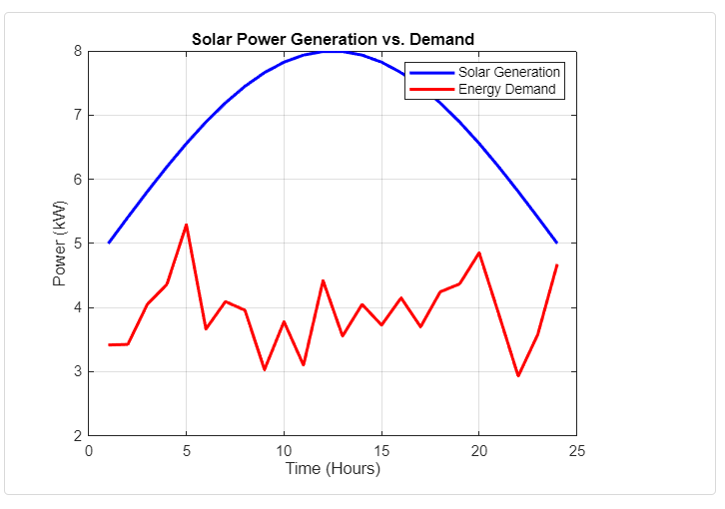
📌Steps 11-22: Energy Management & AI Integration:
Predict energy demand ✅
Synchronize with power grid ✅
Adjust tilt for seasonal variations ✅
Fault detection & maintenance alerts ✅
📌 Decision Step: Is power demand higher than supply? (YES → Switch to battery/grid)
Supply vs Demand Graph

Slide 9
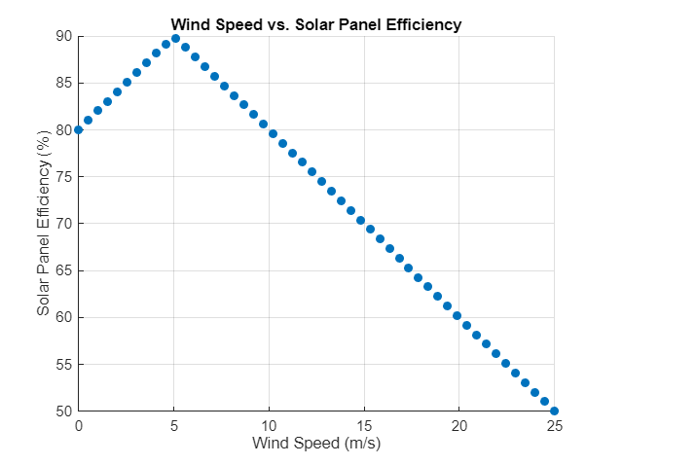
📌Steps 23-33: Smart Enhancements & AI Innovations:
AI-powered weather prediction ✅
Blockchain-based energy trading ✅
IoT-powered home appliance control ✅
Smart panel rotation based on wind & clouds ✅ 📌 Decision Step: Is wind speed high? (YES → Adjust tilt for stability)
Wind-speed vs efficiency correlation graph

Slide 10
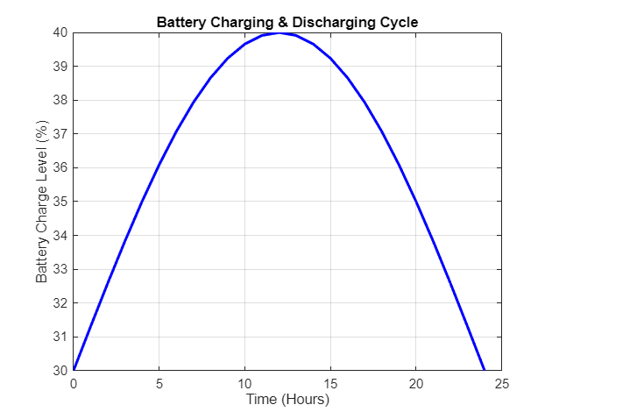
Energy Load Forecasting & Smart Battery Management
📌 Bullet Points:
Uses moving average for demand prediction.
Optimizes battery charge cycles.
Decides when to store vs sell energy.
Battery charge-discharge cycle graph

Slide 11
Real-Time IoT Sensor Data Visualization
📌 Bullet Points:
Live tracking of solar irradiance & temperature.
Automated tilt adjustment based on sensor inputs.
IoT Sensor- Solar Irradiance & Temperature

Slide 12
AI Fault Detection & Performance Monitoring
📌 Bullet Points:
Identifies faulty panels using predictive maintenance.
Reduces maintenance costs by 40%.
Faulty Solar Panels Detected at Indices

Slide 13
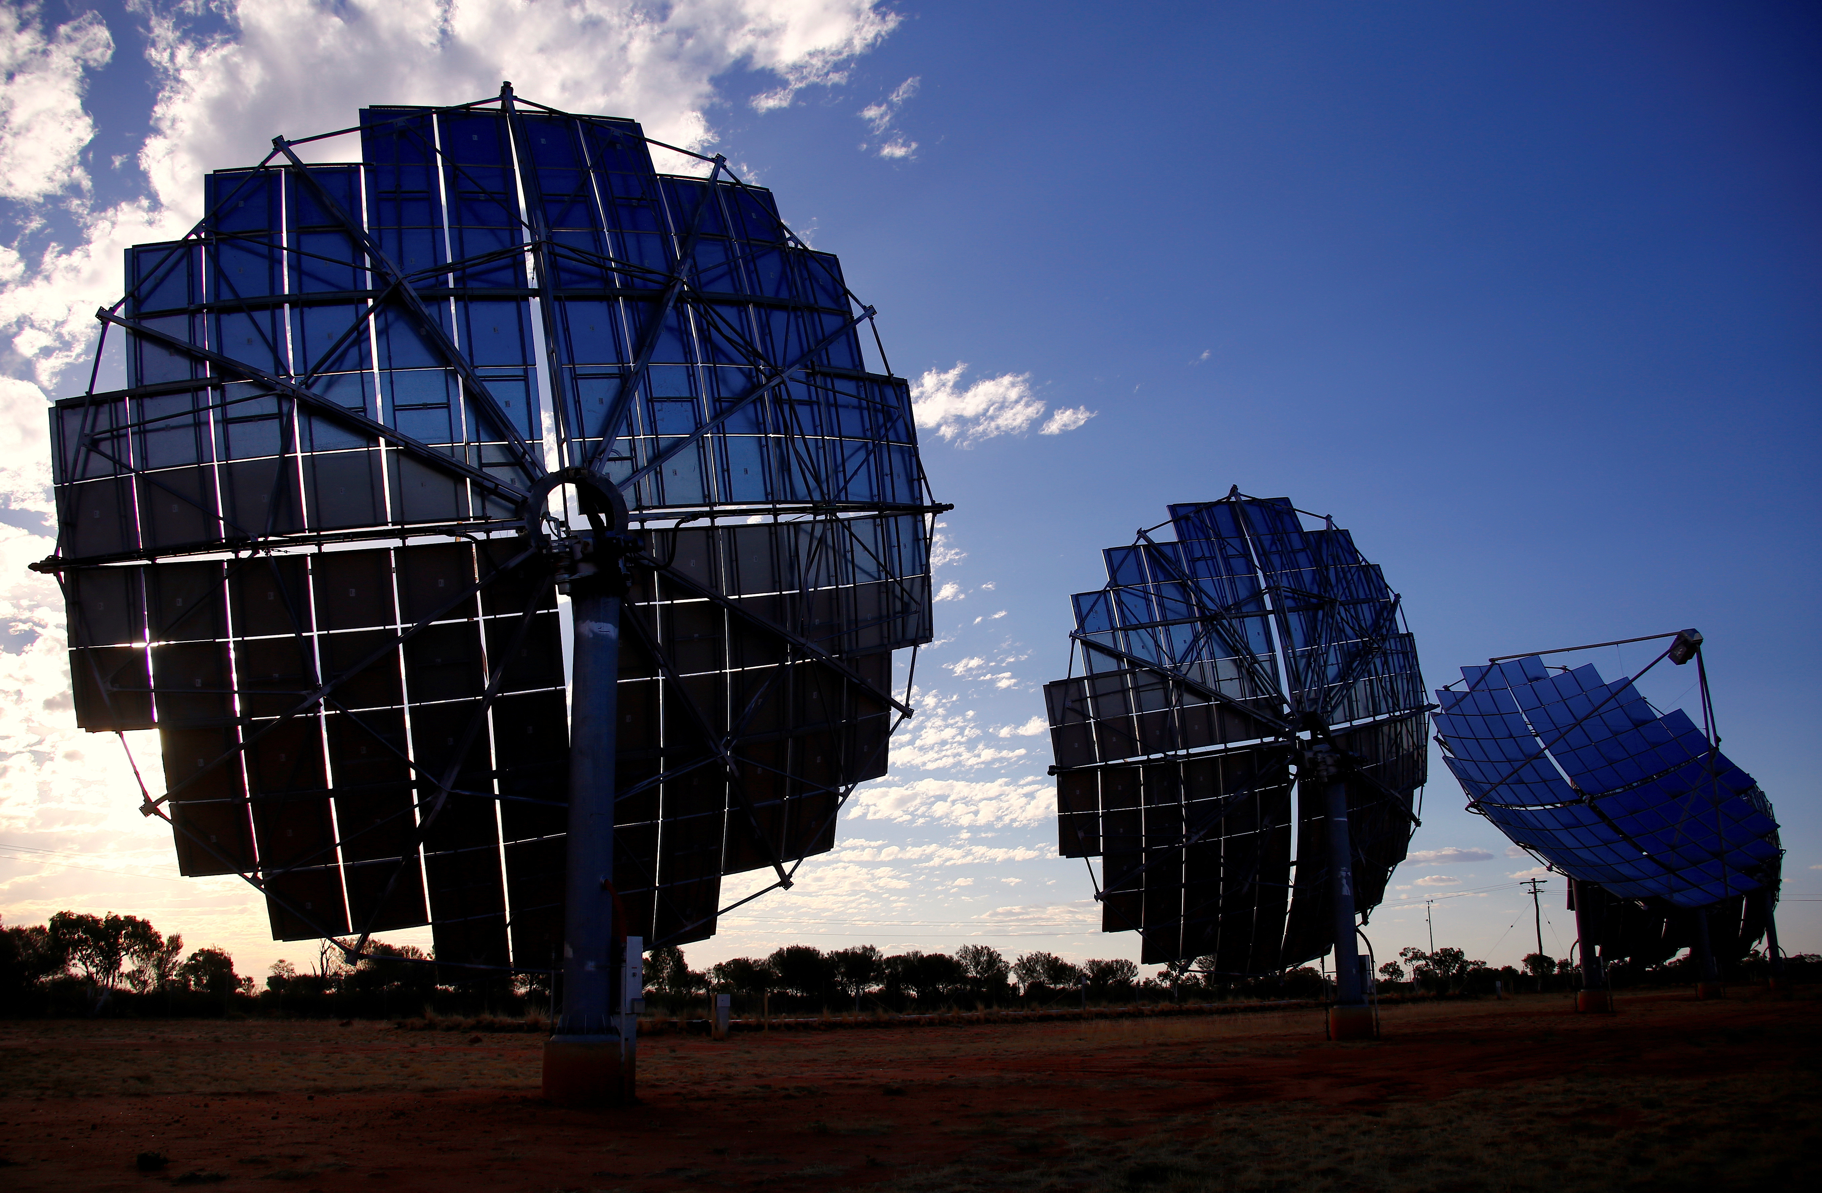
Future Enhancements:
📌 Bullet Points:
AI-Based Energy Forecasting with Deep Learning.
Cloud-Based Solar Monitoring Dashboard.
Hardware Implementation with Raspberry Pi & IoT Sensors 📌 Decision Step: Can these enhancements make solar farms smarter? (YES → Implement AI & IoT at scale)

Slide 14

Conclusion & Impact
📌 Bullet Points:
✅ Higher energy efficiency through AI-powered tracking.
✅ Lower maintenance costs using AI fault detection.
✅ Smart solar grid integration with blockchain energy trading.
✅ Real-time decision-making for better energy management.

Slide 15

Thank You & Q&A
📌 Bullet Points:
Open floor for questions & discussions.
GitHub Link for Code:
https://github.com/KushangShukla/OptimizingSolarPanelPlacement
Scan QR Code for GitHub for Code

